Slide 1
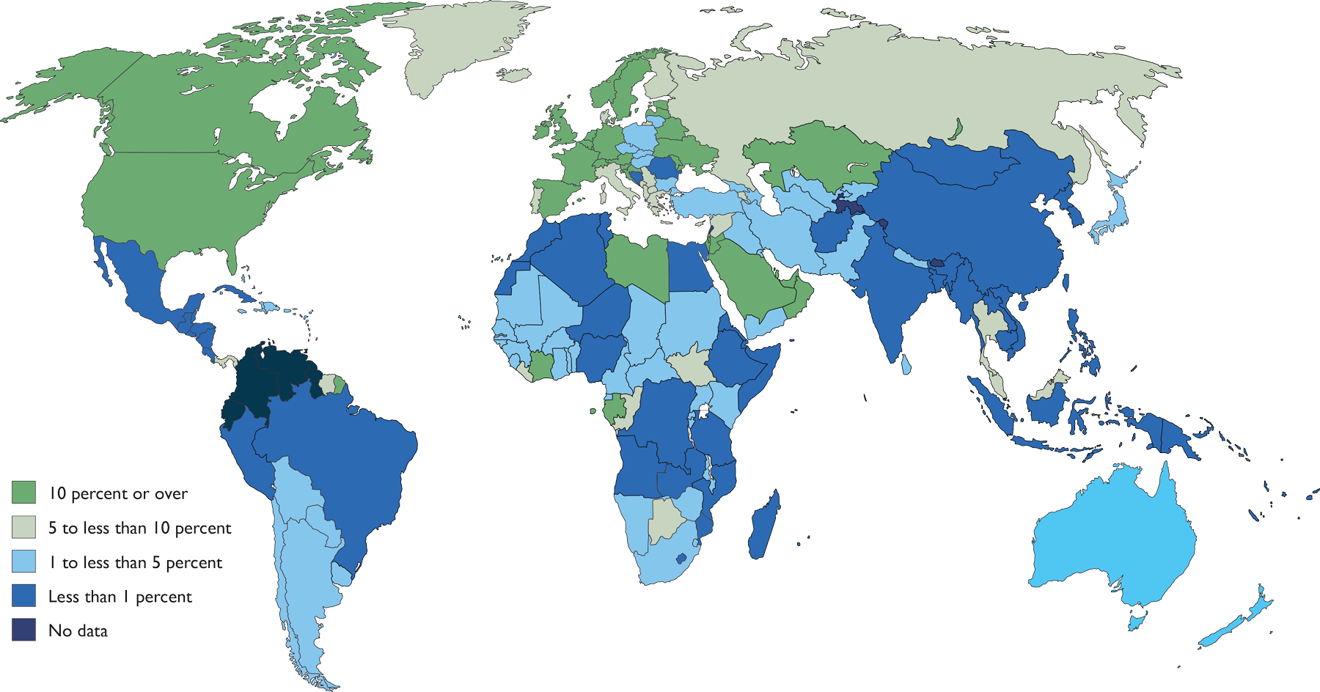
International immigrants as percentage of total population (2013).
Source: United Nations, Department of Economic and Social Affairs, Population Division (2013).
Trends in International Migrant Stock: The 2013 Revision (United Nations database, POP/DB/MIG/Stock/Rev.2013).

Slide 3
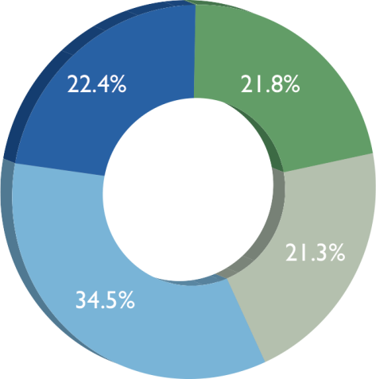
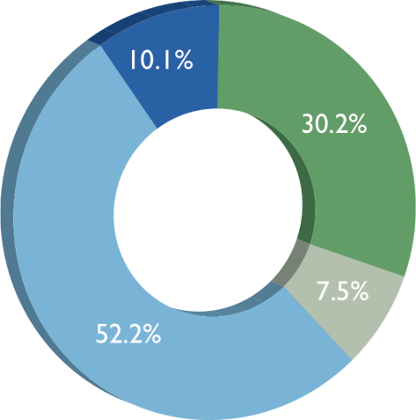
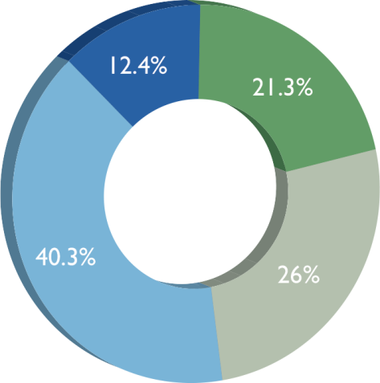
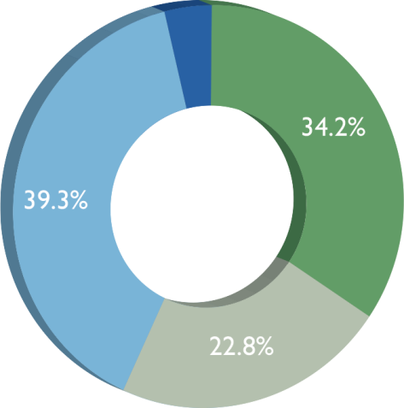
Should immigration (in this country) be kept at its present level, increased, or decreased?
The World View
Europe
Africa
North America
Present level
Increased
Decreased
Don’t know/Refused

Slide 4
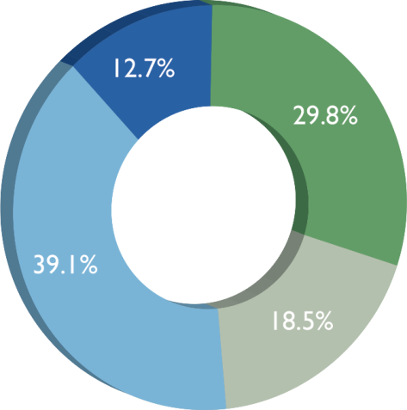
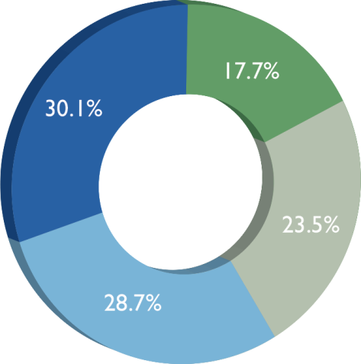
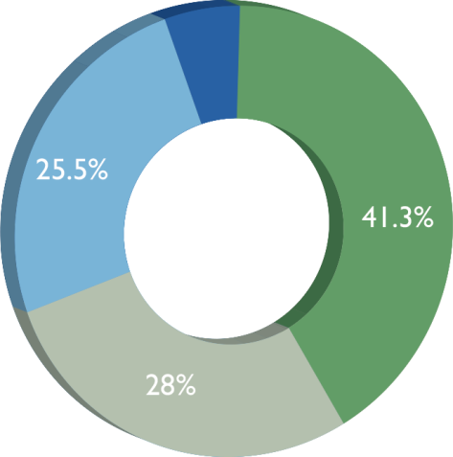
Should immigration (in this country) be kept at its present level, increased, or decreased?
Latin America and Caribbean
Asia
Oceania
Present level
Increased
Decreased
Don’t know/Refused

